Slide 1
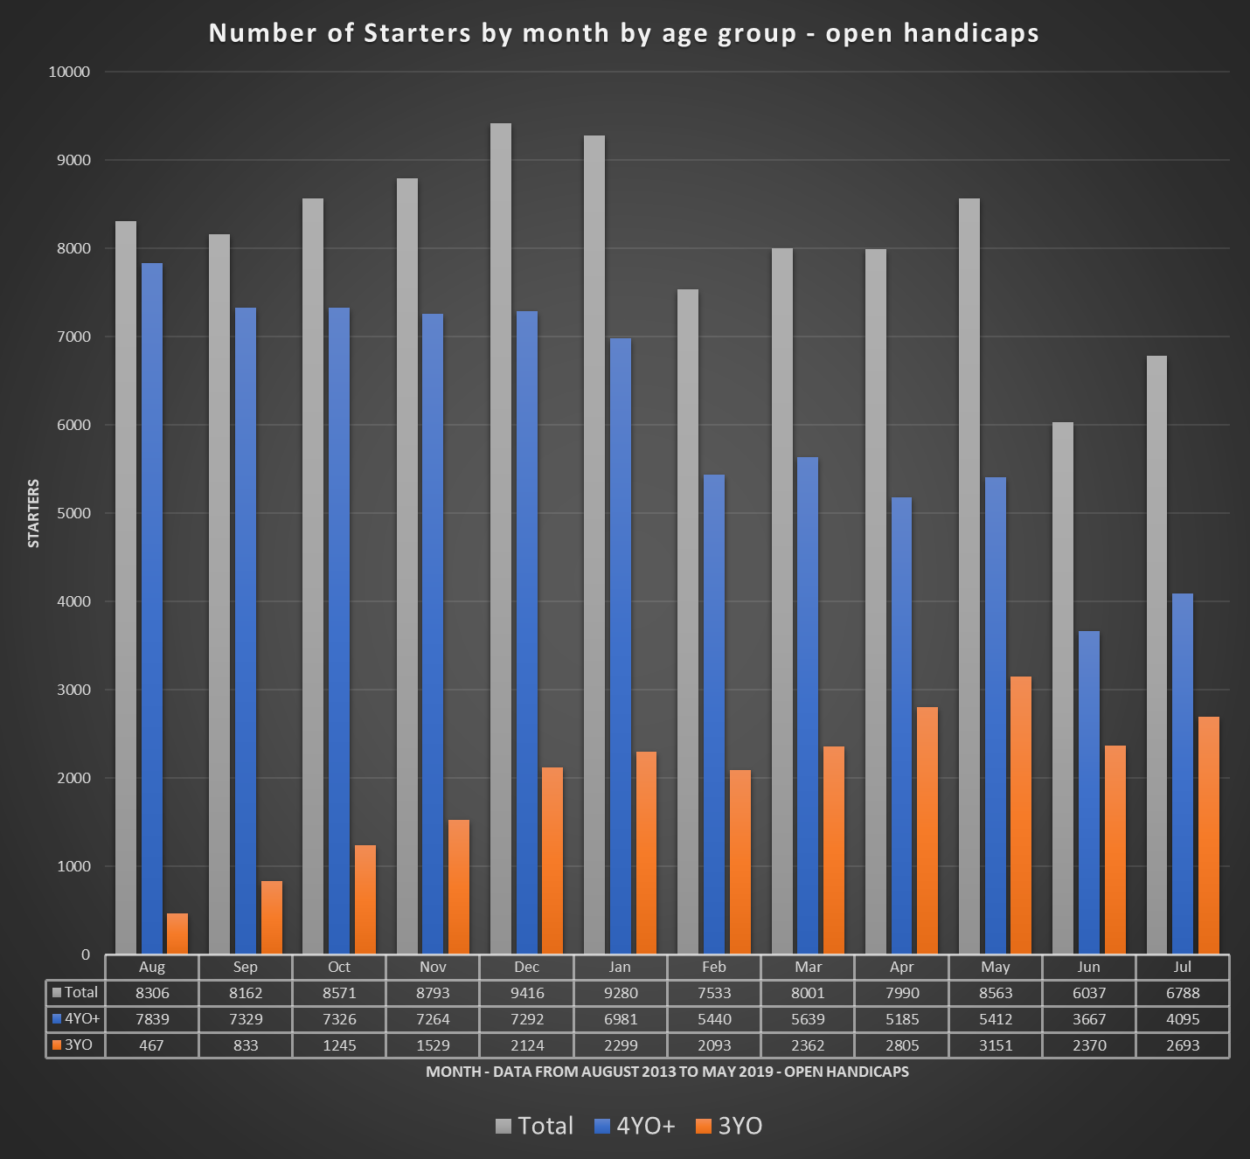

Slide 2
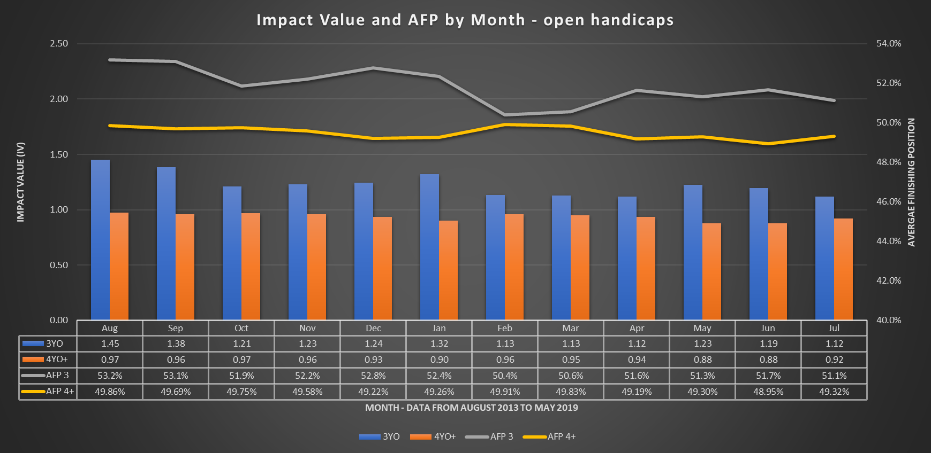

Slide 3
Plate Races
Total observations – 8449 – very small and not ideal
Observations drop off as season progresses
Three-year-olds outperform in all months except May
Outperformance is 26% against older horses throughout year
Outperformance is 14% above average
Data from August 2013 – May 2019
AFP above 50% for 3yos in all months except May
Does not negate evidence found in handicaps races

Slide 4
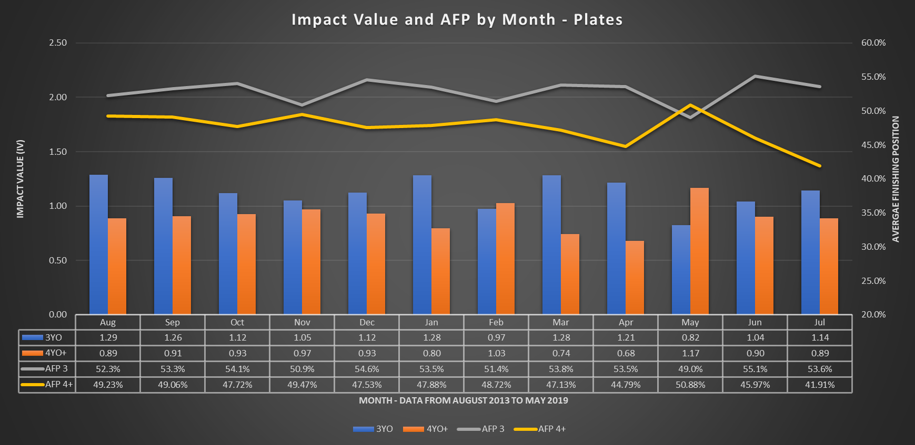

Slide 5
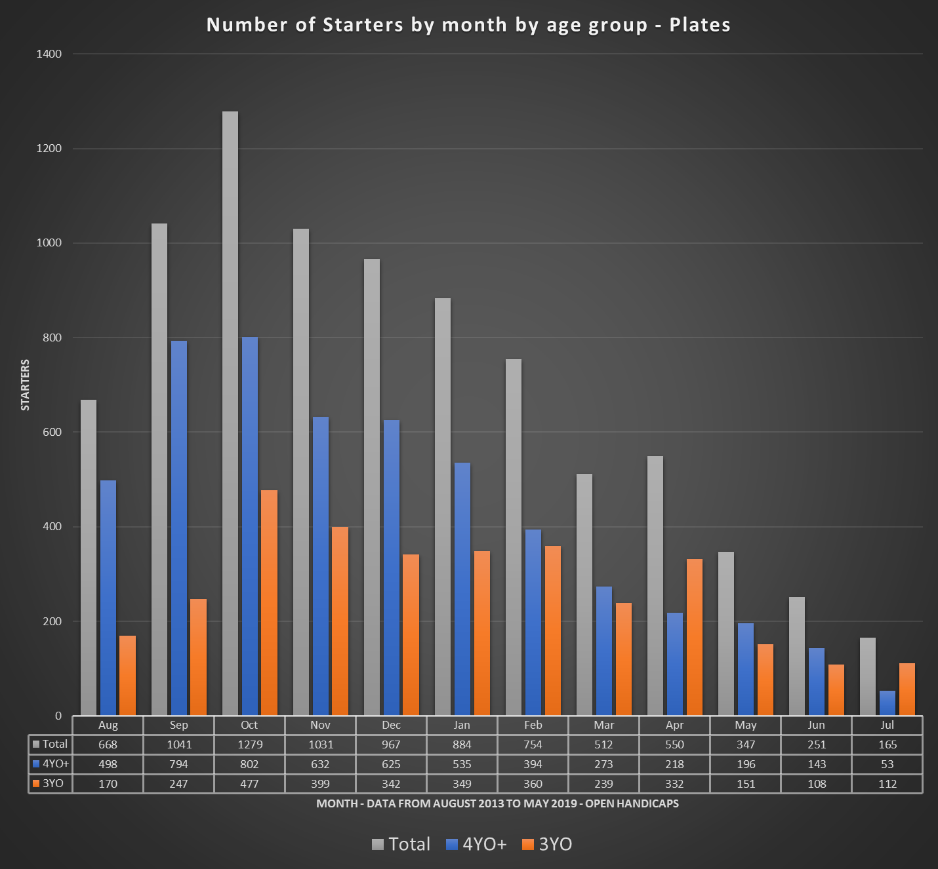

Slide 6
Maiden Races
Total observations – 77305 – drop off sharply in second part of season
Peak observations in Oct to Dec then rapid decline
3yos make up 73.7% of all observations – opposite to handicaps
No WFA and horses run at fixed weights
3yos outperform by 24.8% against older horses and 5% above average
3yos outperform on Impact Value in all months
3yous outperform on AFP in 8 of 12 months
Rapid decay in data integrity post January as poorer class 4yos cannot break Maiden

Slide 7
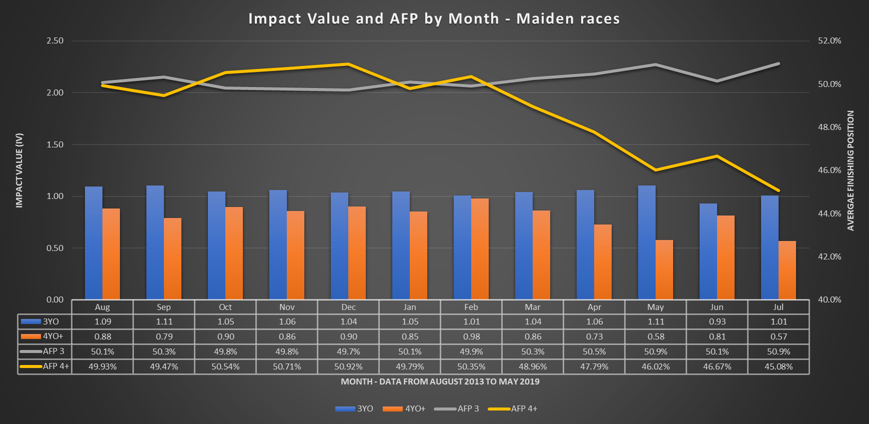

Slide 8
